Slide 1

Network Intrusion Detection
PRESENTATION
Presented by :
Mohamed Amer

Slide 2
Agenda
Introduction
Background
Machine learning model
Implementation
Performance Analysis
Key Findings & Challenges
Conclusions

Slide 3
Introduction to
Network intrusions

Slide 4
Why network safety matter?
Networks are the critical infrastructure for every enterprise and organization
The rapid evolution of AI and technology increases the security risks
Data privacy and confidentiality is a growing concern to everyone

Slide 5
Intrusion Detection Systems (IDS)
Goal: Detect any unusual activity in the network
Challenge: Real-time detection with a very high accuracy
Solution: Machine learning approach
Advantage: leveraging data abundancy to efficiently train machine learning models

Slide 6
Background
Exploring types of IDS and dataset

Slide 7
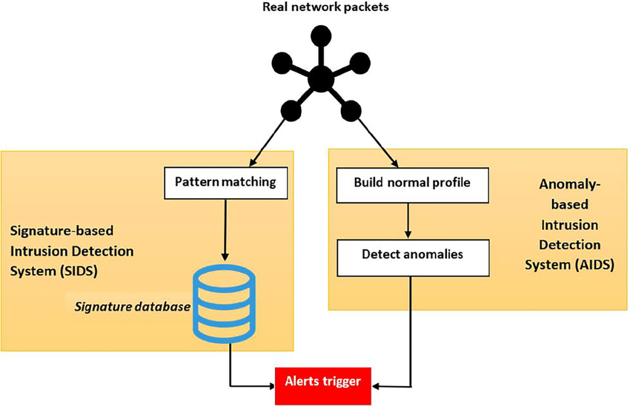
Types of IDS

Slide 8
Anomaly-based intrusion detection system:
Defines profiles of normal user behavior
Detects deviations from normal patterns [2, 3]
Signature based IDS
Defines unique signatures for known attacks
Stores signatures in a database
Matches network activity against signatures [2, 3]

Slide 9
Limitations of SIDS and AIDS
Signature-Based IDS (SIDS):
Fails to detect new types of attacks
Requires a huge extensive database containing signatures of known attacks
Requires high computational requirements [3,4]
Anomaly-Based IDS (AIDS)
Difficulty distinguishing normal vs. abnormal
IoT devices complicate profile definition [3, 4]
Advantages:
Can detect novel and new attack types
Adaptive to changing patterns [2]

Slide 10
Datasets
KDD1999 and NSL-KDD

Slide 11
KDD 1999 Cup Dataset
Characteristics:
Raw TCP/IP traffic capture
41 total features (3 qualitative + 38 quantitative
Binary target variable
Acquisition from Simulated attacks on U.S Air Force LAN [1]
Features categories:
Basic TCP Features
Extracted from basic TCP Connection behavior
Content Features
Inspected payload and content of connection
Time-based Features
Connections to same host in past 2 seconds
Host-based Features
Same as time-based but with a larger time window

Slide 12
KDD 1999 Cup Dataset
Types Of Network attacks simulated [1]
Denial of Service (DoS)
Overloading computing and memory resources
User to Root (U2R) Authentic account access then exploits vulnerability to gain root access
Remote to Local (R2L)
Sending unauthorized packets to a machine to gain access
Probing Attack
Attempting to gather network information to breach security and gain access.

Slide 13
Issues in Dataset
Probing Attack
Attempting to gather network information to breach security and gain access.
User to Root (U2R) Authentic account access then exploits vulnerability to gain root access
Major Problems [1, 5]:
Redundant Records
Class imbalance
Lack of labelled validation dataset
Remote to Local (R2L)
Sending unauthorized packets to a machine to gain access
Denial of Service (DoS)
Overloading computing and memory resources
Modified KDD Data set (NSL-KDD)
Removed redundant rows
Tailored for better performance
Includes binary and multi-class labels
Includes proper validation dataset with labels

Slide 14
Issues in Dataset
Probing Attack
Attempting to gather network information to breach security and gain access.
User to Root (U2R) Authentic account access then exploits vulnerability to gain root access
 | Original Records | Distinct Records | Reduction Rate
Attacks | 3,925,650 | 262,178 | 93,32%
Normal | 972,781 | 812,814 | 16,44%
Total | 4,898,431 | 1,074,992 | 78,05%
Remote to Local (R2L)
Sending unauthorized packets to a machine to gain access
Denial of Service (DoS)
Overloading computing and memory resources
Statistics of Redundant records in KDD Train Set

Slide 15
Data Preprocessing
Probing Attack
Attempting to gather network information to breach security and gain access.
User to Root (U2R) Authentic account access then exploits vulnerability to gain root access
Removed always zero features
Applied Hot Encoding for categorical variables
Used principal component analysis (PCA)
Scaled the data and dropped low importance features
Remote to Local (R2L)
Sending unauthorized packets to a machine to gain access
Denial of Service (DoS)
Overloading computing and memory resources

Slide 16

Machine Learning
Model

Slide 17
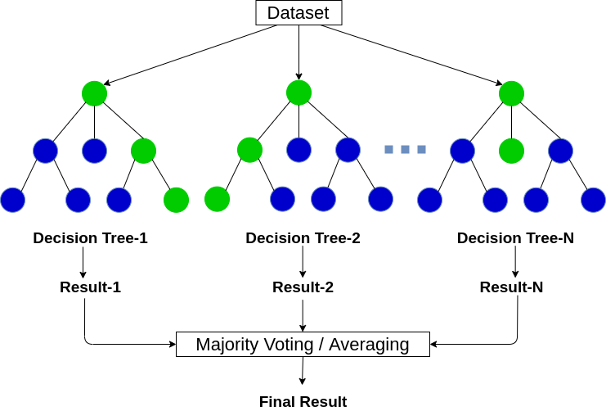
Random Forest Classifier
Probing Attack
Attempting to gather network information to breach security and gain access.
User to Root (U2R) Authentic account access then exploits vulnerability to gain root access
Algorithm overview:
Random Forest combines multiple decision trees to create a robust classifier.
Remote to Local (R2L)
Sending unauthorized packets to a machine to gain access
Denial of Service (DoS)
Overloading computing and memory resources

Slide 18
Mathematical Equations
Binary Splitting: R₁(j,s) = {x | xⱼ < s} R₂(j,s) = {x | xⱼ ≥ s} Gini Index (Purity Measure): G(t) = 1 - Σₖ₌₁ᴷ pₖ²
Uses Recursive binary splitting to partition data
Gini Index to measure the purity of the split
Goal: Find best parameters (j,s) that would result in the purest split
Challenge: Easy to overfit when trees become too deep

Slide 19

Performance
Analysis

Slide 20
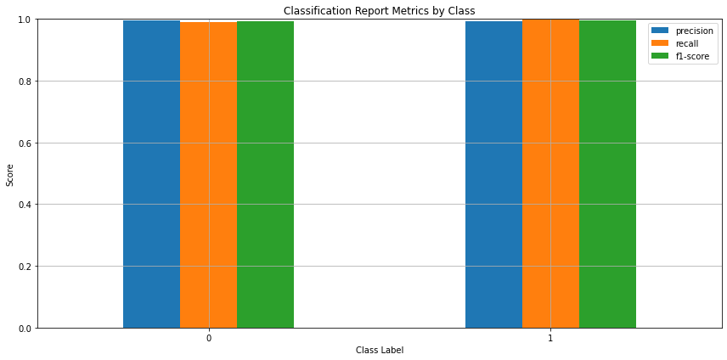
Performance Analysis
KDD 1999 Dataset
Splitting the training data due to lack of labels in the validation dataset
Probable issues:
High accuracy on both training and validation does not guarantee real world accuracy
Model likely memorizing data patterns as data is similar due to redundancy

Slide 21
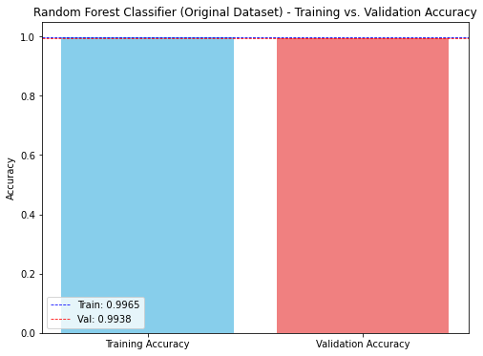
Performance Analysis
KDD 1999 Dataset

Slide 22
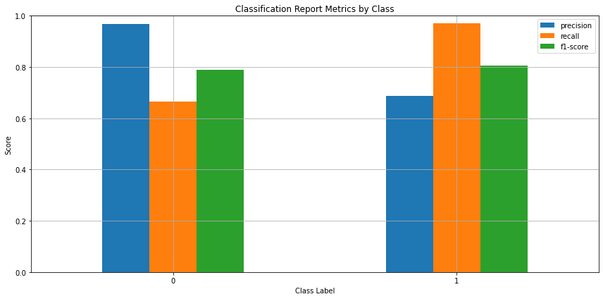
Performance Analysis
NSL- KDD 1999 Dataset
Using the validation set provided

Slide 23
Performance Analysis
NSL- KDD 1999 Dataset
Using the validation set provided
Initial Results when splitting the training dataset:
Was comparable to the original provided data
Model Optimization:
Hyperparameter Tuning
PCA
Data Scaling
Issues to be addressed:
The model showed significant overfitting with training accuracy at 99% while validation remained at 79,9% after extensive tuning

Slide 24
Performance Analysis
NSL- KDD 1999 Dataset
Using the validation set provided
Can it be used:
✓
✗
Strong Attack Detection
Poor Normal Traffic Recognition
Excellent at identifying actual network attacks
Low false negative rate for attacks
High false positive rate
Would flag about 31% of normal connections as probable attacks
Implication:
The High false positive rate would make it impractical for deployment without additional filtering mechanisms

Slide 25

Key Findings
And challenges

Slide 26
Key findings and challenges
Dataset quality is critical:
Dataset quality can introduce bias and misleading results
Technical Challenges:
Overfitting
Class imbalance
Generalization
Feature engineering
Main conclusions?
Trade-off : Security vs usability balance
Validation importance: proper validation data is crucial for realistic performance assessment
The need for more clean appliable data for networks intrusion
More Investigation into machine learning algorithms and advanced techniques

Slide 27
THANK YOU
Mohamed Amer
Hochschule Hamm-Lippstadt
Autonomous Systems A
Summer Semester

Slide 28
References
[1] M. Tavallaee, E. Bagheri, W. Lu and A. A. Ghorbani, "A detailed analysis of the KDD CUP 99 data set," 2009 IEEE Symposium on Computational Intelligence for Security and Defense Applications, Ottawa, ON, Canada, 2009, pp. 1-6, doi: 10.1109/CISDA.2009.5356528. keywords: {Testing;Intrusion detection;Data security;Statistical analysis;Computer security;Computer aided manufacturing;Learning systems;Computational intelligence;Computer networks;Application software},
[2] Z. Ahmad, A. Shahid Khan, C. Wai Shiang, J. Abdullah, and F.Ahmad, ”Network intrusion detection system: A systematic study ofmachine learning and deep learning approaches,” Trans. EmergingTelecommun. Technol., vol. 32, no. 1, e4150, 2021. [Online]. Available:https://doi.org/10.1002/ett.4150
[3] W. Ma, ”Analysis of anomaly detection method for Internet of Thingsbased on deep learning,” Trans. Emerg. Telecommun. Technol., vol. 31,no. 6, e3893, 2020. [Online]. Available: https://doi.org/10.1002/ett.3893
[4] Y. Mehmood, F. Ahmad, I. Yaqoob, A. Adnane, M. Imran, and S.Guizani, ”Internet-of-Things-based smart cities: Recent advances andchallenges,” IEEE Commun. Mag., vol. 55, no. 9, pp. 16–24, Sep. 2017.[Online]. Available: https://doi.org/10.1109/MCOM.2017.1600514
[5] A. R. Tapsoba and T. Fr´ed´eric OUEDRAOGO, ”Evaluation of super-vised learning algorithms in binary and multi-class network anomaliesdetection,” 2021 IEEE AFRICON, Arusha, Tanzania, United Republicof, 2021, pp. 1-6, doi: 10.1109/AFRICON51333.2021.9570886.keywords: Training;Supervised learning;Support vector machineclassification;Predictive models;Prediction algorithms;Featureextraction;Classification algorithms;Intrusion Detection System(IDS);Supervised Learning Algorithms (SLA);Recursive FeatureElimination (RFE);AUC - ROC Curve;NSL-KDD,

